Slide 1
Alterations in Fluid, Electrolyte and Acid-base balance
Chapter 18
Laurine Gajkowski, RN, ND, CPN
NURS 316
August 31, 2021
Notes:
We are starting with this topic since it relates to today’s lab on Peds Math (Fluids & Meds) Safety

Slide 2
Objectives
Describe normal F/E status for children.
Identify threats to f/e balance in children.
Describe acid-base balance and recognize common disruptions.
Plan nursing care for children experiencing F/E problems and acid-base imbalances.

Slide 3
Young children are at risk for f/e imbalance due to differences in body fluid compartments and regulation systems.
Pediatric nurses institute measures to maintain normal body fluids in well children (Such as exercising in hot weather) and ill children (such as gastroenteritis).
The most common electrolyte imbalances involve sodium and potassium.
Normal acid-base balance is necessary for proper cell function in the body.
Alkalosis or acidosis have either a respiratory origin or metabolic origin.

Slide 4
Body fluid
Intracellular fluid (I C F)
2/3 of body water
More difficult to dehydrate
Contains large amounts of K⁺
*Extracellular fluid (E C F)
1/3 of body water
More easily lost dehydration
Contains mostly Na⁺, Cl⁻, and HCO₃⁻
^{Location:}
Intravascular
Interstitial
Lymph
Transcellular
Body water percentage for weight varies with age.
Newborns have highest percentage of water.
Percentage decreases with increasing age.
Notes:
ECF is mostly water, Na, and Cl – . THEREFORE: Normal saline (NS) is the replacement solution for dehydration.
ECF is easy to replenish
We don’t give K to people who have lost fluid; because K is usually normal
Lot of potassium inside your cells

Slide 5
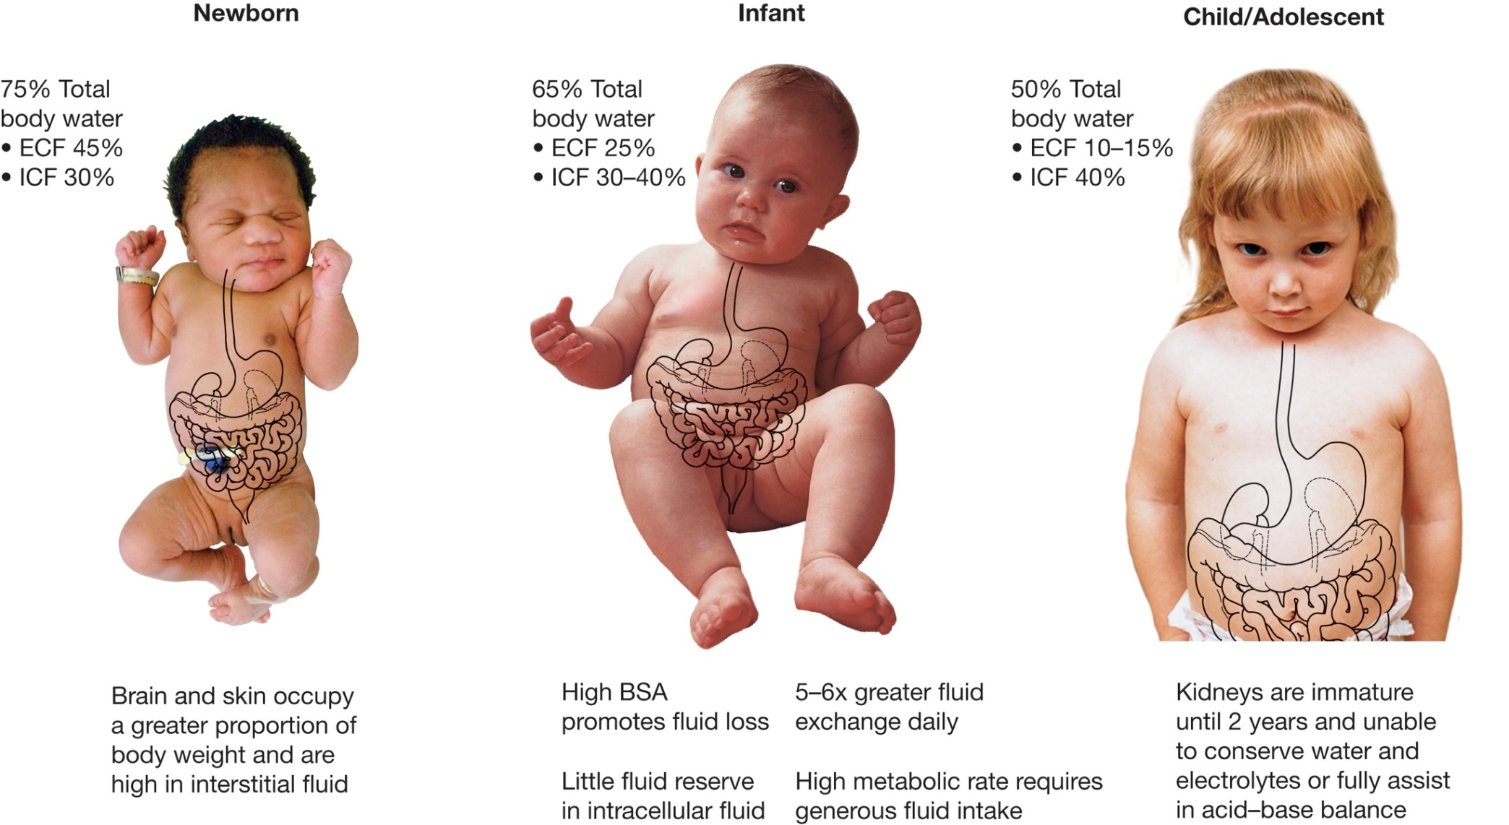
Fluid differences in children
Notes:
Infants have more folds and more body surface area (more fluid loss! )

Slide 6
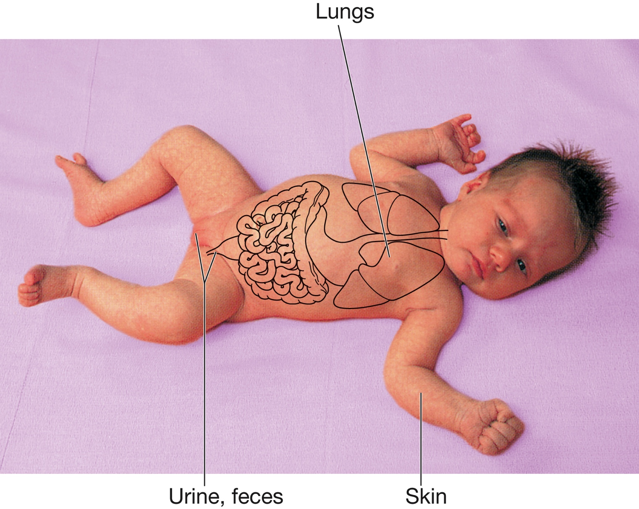
Figure 18-2 Normal Routes of Fluid Excretion from Infants and Children
Notes:
High fluid loss (through lungs and eyes). Breathing faster! Hohoho
Kidneys immature before age 2 years.

Slide 7
F/E Imbalances
Fluid volume deficit
Fluid Volume Excess
Dehydration
Isotonic (Na: 134-143 mEq/L)
Hypotonic
Hypertonic
Children can have severe complications from dehydration. Death can occur.
Interstitial = edema
Extracellular

Slide 8
Under normal conditions, fluid ingested should equal fluid lost.
Fluid Loss
SENSIBLE
measurable
via urine, liquid stool, etc
INSENSIBLE
immeasurable
via skin, respiratory tract, etc.

Slide 9
Dehydration
A critical condition that results from an extracellular fluid loss (total output > total intake)
Possible Causes
Vomiting
Diarrhea
Burns
Hemorrhage
Nasogastric suctioning and drainage loss
NPO status or inadequate fluid/food intake due to illness
Overuse of diuretics or enemas
Adrenal insufficiency

Slide 10
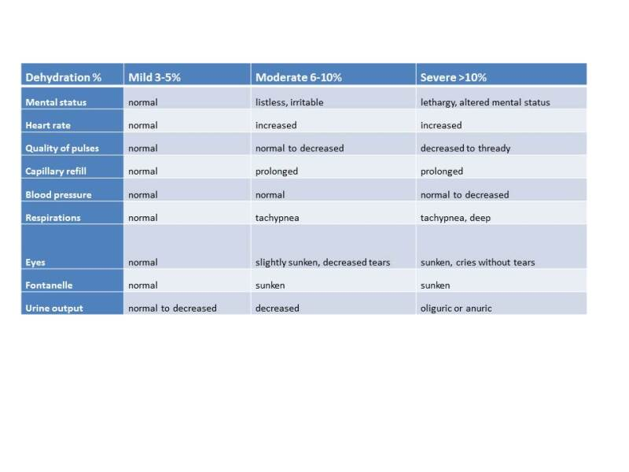
Notes:
% dehydrated means % of body weight lost

Slide 11
Nursing Care
Prevent dehydration
Parent education for mild or moderate
-Provide oral rehydration fluids (1-3 teaspoons every 10 minutes) or 50/ml/kg in 2-4 hours
Acute care for severe
-Monitor weight, I&O, HR, BP, skin turgor, cap refill, fontanelle (infant), urine specific gravity
-Administer IV fluids
Notes:
Electrolyte solution
(dilute gatorate because its too much sugar)

Slide 12
ECF Excess: Saline excess or volume overload
Excessive aldosterone secretion
Congestive heart failure
Liver cirrhosis
Chronic renal failure
Glucocorticoid medications
Improper IV regulation by nurse

Slide 13
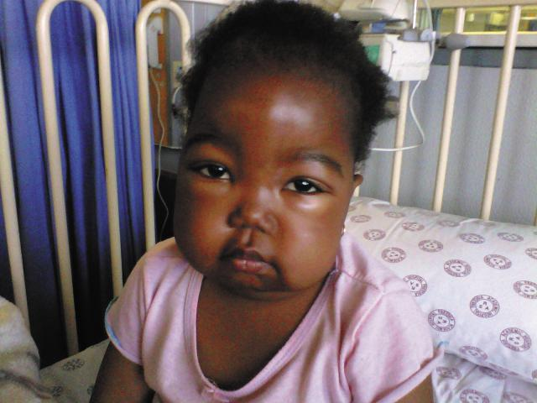
ECF (Interstitial) Fluid volume excess: Edema
Increased blood hydrostatic pressure
Decreased blood osmotic Pressure (low serum protein)
Increased interstitial fluid osmotic pressure (high capillary permeability)
Blocked lymph drainage

Slide 14
Electrolyte imbalances
Sodium
potassium

Slide 15
Hypernatremia
Increased osmolality of the blood
Symptoms are Thirst and mental changes due to shrinking of brain cells
Causes are
A. loss of more water than sodium (vomiting and diarrhea without fluid replacement, inadequate oral intake, increased aldosterone)
or
B. Gain of more sodium than water (no access to water, too highly concentrated formula, IV or hypertonic saline)

Slide 16
Hyponatremia
Decreased osmolality of the blood, too dilute
Symptoms are mental changes due to swelling of brain cells. It is a frequent cause of seizures in infants under 6 months.
Causes are
A. Gain of more water than sodium(too diluted infant formula, too much D₅W IV, tap water enemas)
or
B. loss of more sodium than water (vomiting and diarrhea with tap water replacement not Ors, sweating, diuretics)
Notes:
ORS is the abbreviation for oral rehydration solution

Slide 17
Hyperkalemia
K⁺ level above 5.5 mmol/l
Symptoms relate to muscle dysfunction: heart, GI (constipation), skeletal
Causes: renal insufficiency, too much IV potassium intake, shift of potassium out of cells (acidosis)
Nursing care: stop IV potassium, EKG, safety, restrict high potassium foods, administer clinical therapy to lower K+ (dialysis, Kayexalate, meds that drive K+ into the cells).
Notes:
Can be treated with Sodium polystyrene sulfonate or Kayexalate mixed in sorbitol is a cation-exchange resin that binds potassium in the gastrointestinal tract and eliminates it from the body. Each gram of resin will bind approximately 1mEq of potassium and release 2 to 3 mEq of sodium. It should be given at a dose of 1 g/kg orally or per rec-tum (maximum dose: 60 g) and repeated every 1 to 2hours until the serum potassium level is lowered

Slide 18
Hypokalemia
K⁺ level below 3.7 mmol/l
Symptoms relate to muscle dysfunction: heart, GI, respiratory, skeletal
Causes: Excretion of K from GI tract (NG losses, bulimia, meds)
Nursing care: arrhythmias, assess for leg weakness, teach about potassium rich foods

Slide 19
Acid-base imbalances
Acidosis (too much acid)
Alkalosis (too little acid)

Slide 20
Respiratory acidosis
Carbonic acid excess
Caused by anything that interfere with the lungs ability to excrete carbon dioxide (pneumonia, muscular dystrophy, sleep apnea)

Slide 21
Respiratory alkalosis
Carbonic acid deficit
Caused by hyperventilation

Slide 22
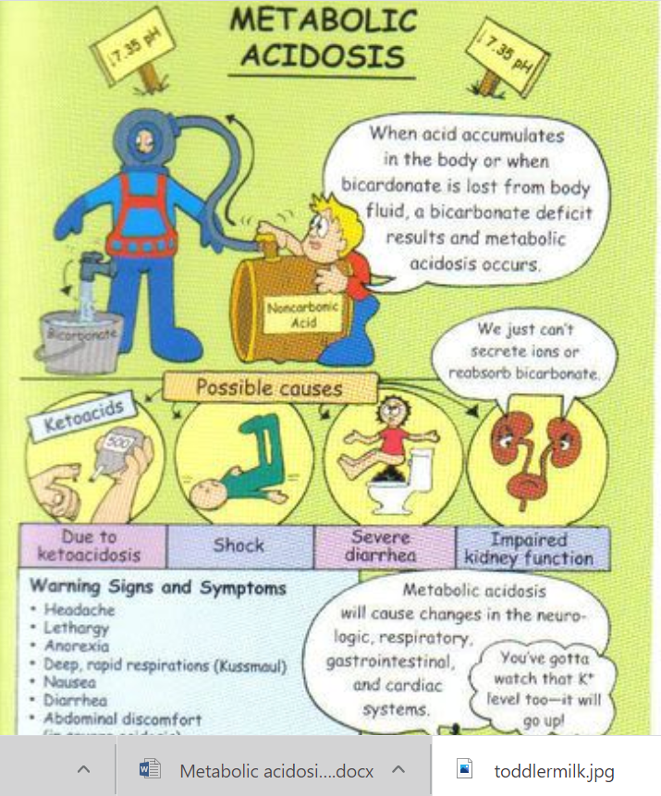
Metabolic acidosis
Excess of any acid other than carbonic
Caused by cells making acid that can’t be excreted (DKA, starvation), eating acid, or losing bicarb

Slide 23
Metabolic alkalosis
Too few metabolic acids
Caused by excess intake of bicarbonate or excess loss of acid through vomiting (pyloric stenosis)

Slide 24


